Slide 1

INTRODUCTION TO COMPUTER NETWORKS
ENDSEM PROJECT
GROUP-12

Slide 2
TEAM MEMBERS
VENKATA SATYA-CB.EN.U4AIE22005
KOLLA LOKESH-CB.EN.U4AIE22027
SURYA TEJA-CB.EN.U4AIE22069
RAMA KRISHNA PRASAD-CB.EN.U4AIE22070

Slide 3
LIVE MEETING
&
TIC-TAC-TOE GAME
WITH
SOCKET PROGRAMMING

Slide 4
LIVE MEETING WITH SOCKET PROGRAMMING

Slide 5
INTRODUCTION
One way to add a dynamic and real-time element to distant communication and collaboration is through socket programming live meetings.
Using network sockets to create communication channels between various devices or applications is known as socket programming. Socket programming makes it possible for participants in live meetings to establish a direct and ongoing connection, facilitating the smooth interchange of data and information.
Socket programming creates a networked environment where real-time data transmission is possible between participants in a live meeting and a central server.
Features like collaborative document sharing, audio and video streaming, and instant chat are made possible by this direct communication route.

Slide 6

Furthermore, socket-programmed live meetings provide a great deal of flexibility and scalability. The design enables the integration of several capabilities, including synchronized interactions, real-time updates, and personalized features catered to the individual requirements of the conference attendees.
One of the key advantages of incorporating socket programming into live meetings is the low-latency communication it enables.

Slide 7
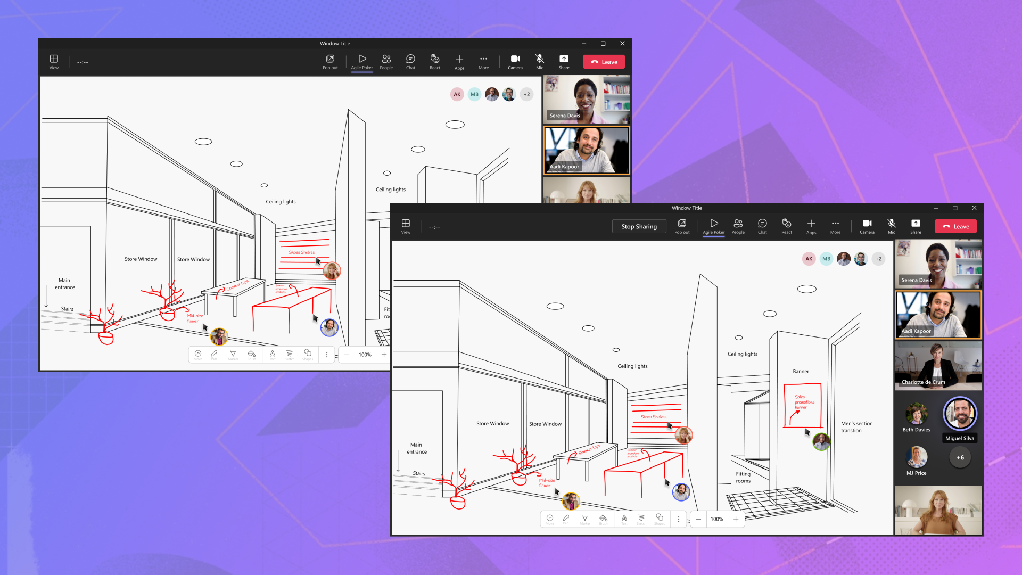
Screen sharing can also be done between the host and clients in the meeting.
In order to promote real-time interactions, increase engagement, and get around the drawbacks of conventional online communication techniques, live meetings using socket programming offer a stable and responsive platform.

Slide 8
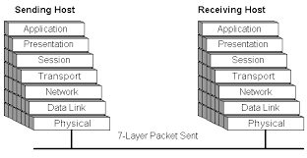
LAYERS INVOLVED
Because the transport layer handles things like flow management, error checking, and connection establishment and termination, socket programming significantly depends on it. Because TCP is connection-oriented, it is frequently employed in situations where the transmission of data must be dependable and well-organized, as is frequently the case in live meetings.

Slide 9
In conclusion, even though socket programming is frequently connected to the transport layer, the larger OSI or TCP/IP model offers a useful framework for comprehending the many functions and abstraction levels required to enable live

Slide 10
SERVER CODE OVERVIEW
Server script for a live meeting system, including screen sharing, video streaming, and audio sharing functions using socket programming. Three separate sockets, each connected to a different port, are initialized to handle screen, video, and audio data. Upon client connection, the corresponding client sockets and addresses are obtained.
The script executes procedures that continuously receive data for simultaneous screen, video, and audio sharing via threading from connected clients. Before the incoming screen images are shown in a tkinter label, they are handled by the Pillow library.
OpenCV is used to handle video frames, while the sounddevice library is utilized to play back audio data. Toggle screen, video, and audio sharing with the tkinter GUI's buttons.

Slide 11
CLIENT CODE OVERVIEW
For a live meeting system, client application with screen sharing, video streaming, and voice sharing capabilities.
The script makes advantage of socket programming to establish a connection to a server at a certain IP address (SERVER_HOST) and port numbers (SERVER_PORT_SCREEN, SERVER_PORT_VIDEO, SERVER_PORT_AUDIO).
The client software uses the tkinter library to construct a graphical user interface (GUI) that allows users to initiate and stop screen sharing, video streaming, and audio sharing. Each sharing function uses a different thread for concurrent execution.
The screen-sharing feature uses the ImageGrab module to continually send screen data back to the server after resizing a screenshot of the user's screen. The video sharing app makes use of the user's camera.

Slide 12
ability to record frames, which are then delivered to the server via pickle after being serialized. The audio sharing feature records audio from the user's microphone using the sounddevice libraries. After then, the server receives the audio in chunks. Furthermore, the client displays the video frames it receives from the server in a different thread by using OpenCV.
With buttons to initiate and stop each sharing function, the GUI provides users with an intuitive interface during a live conference.
The script manages the GUI and gracefully ends the connection. It's important to keep in mind that this client-side code collaborates with the server-side implementation to create a complete live meeting system that enables users to take part in interactive screen sharing.

Slide 13
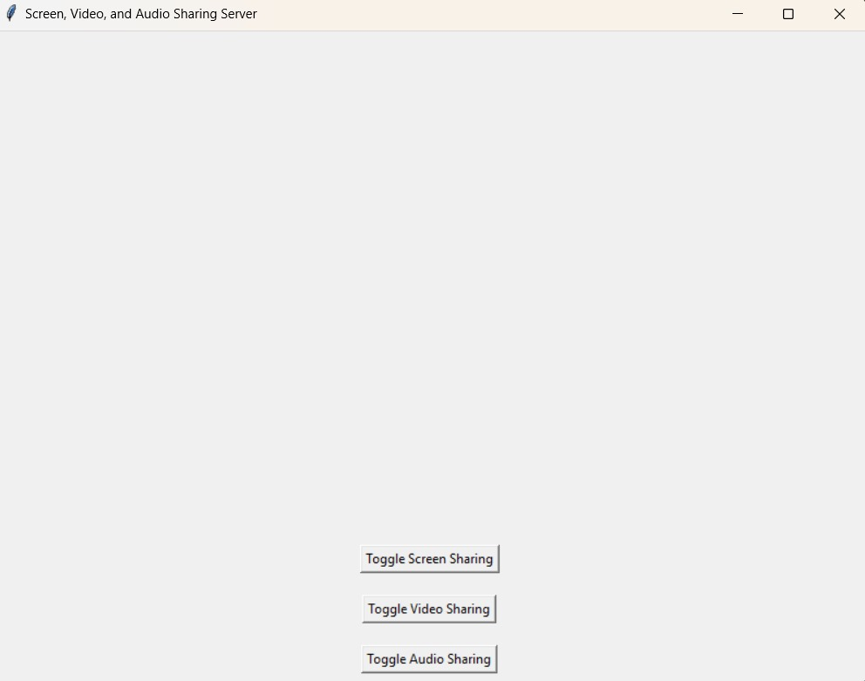
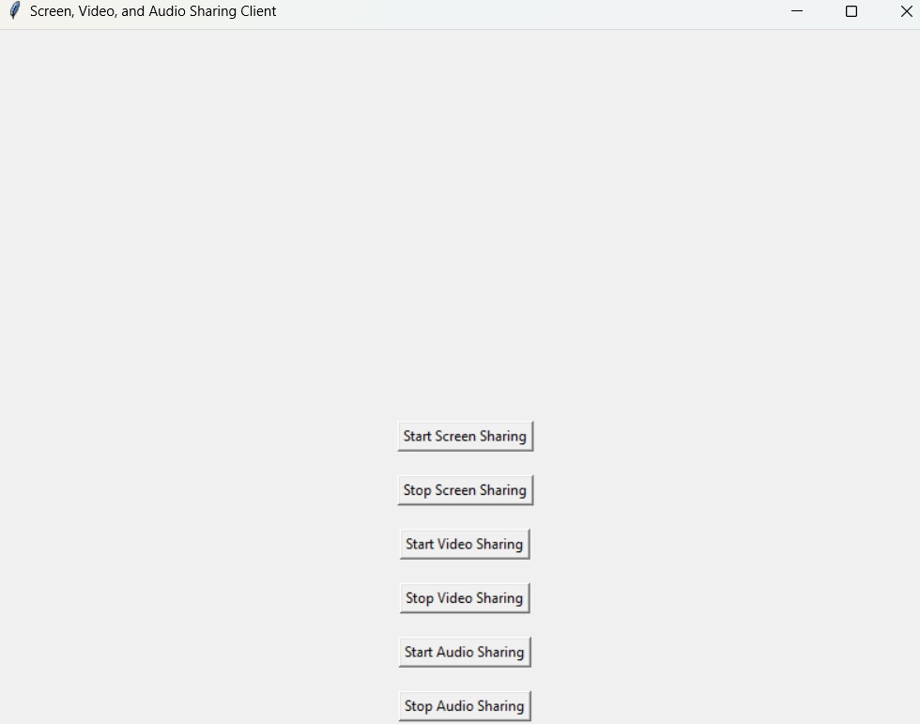
OUTPUT
host side client side

Slide 14
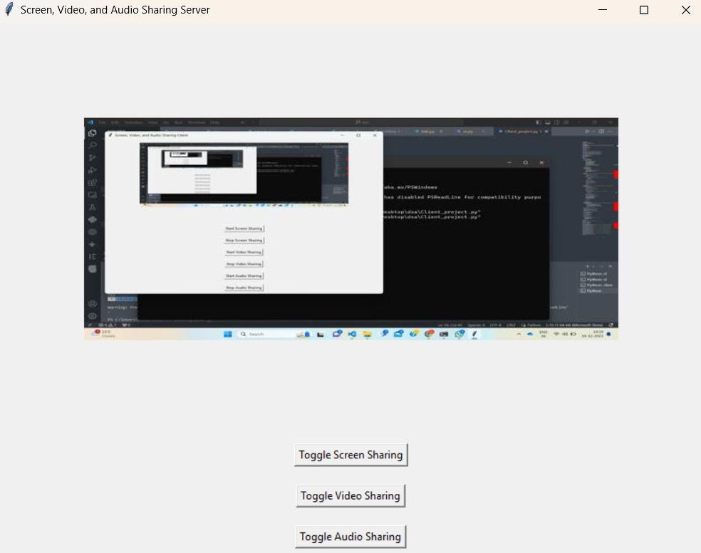
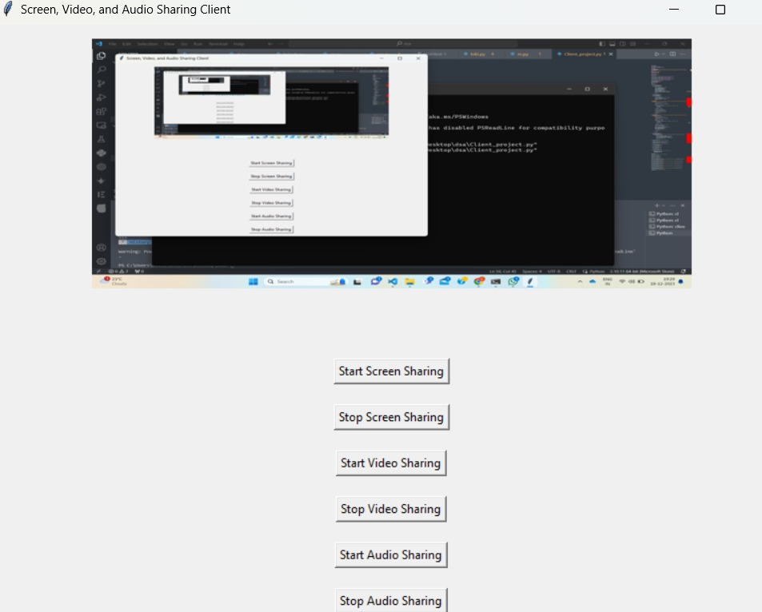
Shared screen Sharing screen
from client to host from client

Slide 15
TIC-TAC-TOE GAME WITH SOCKET PROGRAMMING

Slide 16
INTRODUCTION
Introducing a socket-programmed version of the traditional game Tic-Tac-Toe places it in a contemporary, interactive, real-time setting. Socket programming makes the straightforward yet strategic game of Tic-Tac-Toe more entertaining by enabling players to compete against one another wherever they may be in the world.
Innovative technologies give classic games a fresh lease on life in the digital era. A fun and engaging game experience is produced when the dynamic realm of socket programming is combined with the classic charm of Tic Tac Toe.
This timeless game, renowned for its simplicity, takes on a contemporary twist as players compete against one another in real-time over the broad internet, testing each other's cunning and strategy.

Slide 17
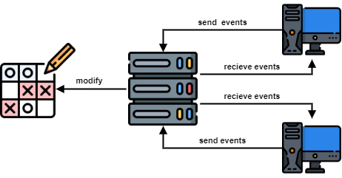

Slide 18
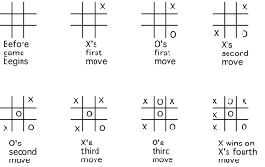
ABOUT THE GAME

Slide 19
CODE OVERVIEW
Here for both the player same code applies but the one runs the code with host game will be player one and the one who runs the code to coonect host will be player two.
By instantiating a TicTacToe object, both the code section starts the hosting of a game of TicTac-Toe and connecting to the game.
It assigns "X" to the player's symbol and "O" to the opponent's symbol. Invoking the host_game function creates a server socket on the localhost at port 9999, which is then used to wait for incoming connections.
The handle_connection function is called on a new thread that has been launched in response to a connection from "player 2" (the client). This approach uses a while loop to keep the game going constantly until the game_over flag is set to true.
The code asks "player1" to enter their move as coordinates (row, column) during the player's turn, if it is "player 1's" turn, as indicated by the self.turn variable. The check_valid_move method is used to validate the move, and

Slide 20
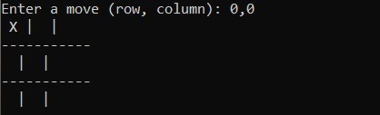
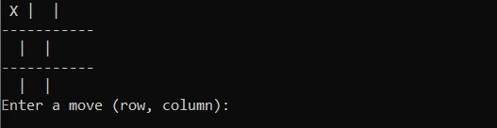
OUTPUT
player 1 of the game player 2 gets the response
start the move with 'X' player 1 and asked to make next move

Slide 21
THANK YOU

